Slide 1
AI Chat Assistant Demo
BY RITHIKA ASHOK

Slide 2
Task:
Design and implement a cost-efficient, retrieval-augmented AI chatbot that can accurately answer customer FAQs and contextually promote the company’s digital products during conversations, that is to be hosted on a web or phone application.

Slide 3
Requirements
FAQ Handling → Retrieve and answer customer questions from a predefined product dataset.
Product Promotion → Recommend relevant digital products naturally within the conversation.
Budget Constraint → Avoid expensive LLM training; use RAG as the approach.
Integration → Demonstrate in a working demo (website + chatbot).
Scalability → Solution should be extendable to larger datasets and product catalogs.

Slide 4
TOOLS
DATABASE: MongoDB (NOSQL)
FRONTEND: REACT.JS
BACKEND: JavaScript, Langchain (LANGGraph)
  Integration: Node.js, TypeScript
LLM: Google Gemini API
The tools and architecture I’ve used so far (React, LangChain, MongoDB, Gemini API) can be adapted based on your preferences*

Slide 5
Approach
Built a mockup ecommerce website, to showcase the AI chatbot.
Mock Data Generation
  Use Gemini LLM to generate fake furniture dataset.
  Validate with Zod before seeding into MongoDB.
Database Setup
  Store product docs + embeddings.
  Create vector index with cosine similarity.
Hybrid Search Agent
  Vector Search (semantic match for "modern wooden chair")
  Keyword Search (exact text match for “chair”)
  Combine results for higher relevance.
Frontend Mockup
  Simple React site showing chatbot interface.
  Users can query and get responses back.

Slide 6
Architecture
Architecture Flow:
User → React Mockup UI → LangChain Agent (Gemini) → MongoDB (vector + keyword) → Agent Response → UI
The project follows a modular LangChain-based pipeline:
  Data Layer: MongoDB Atlas (items + vector index).
  Processing Layer: LangChain tools for hybrid retrieval.
  Reasoning Layer: Gemini LLM as the core agent.
  UI Layer: React mockup site to demonstrate chatbot interaction

Slide 7
AI Chat Assistant Features
Autonomously decides when to search the database vs. when to respond directly.
Uses custom tools to actively search through real product data.
Maintains conversation memory and adapts to failures.
Takes multi step actions: perceive, plan , act and respond.
Uses a Hybrid Search method: both keyword search and vector based search.

Slide 8
DEMO

Slide 9
Code Snippets

Slide 10
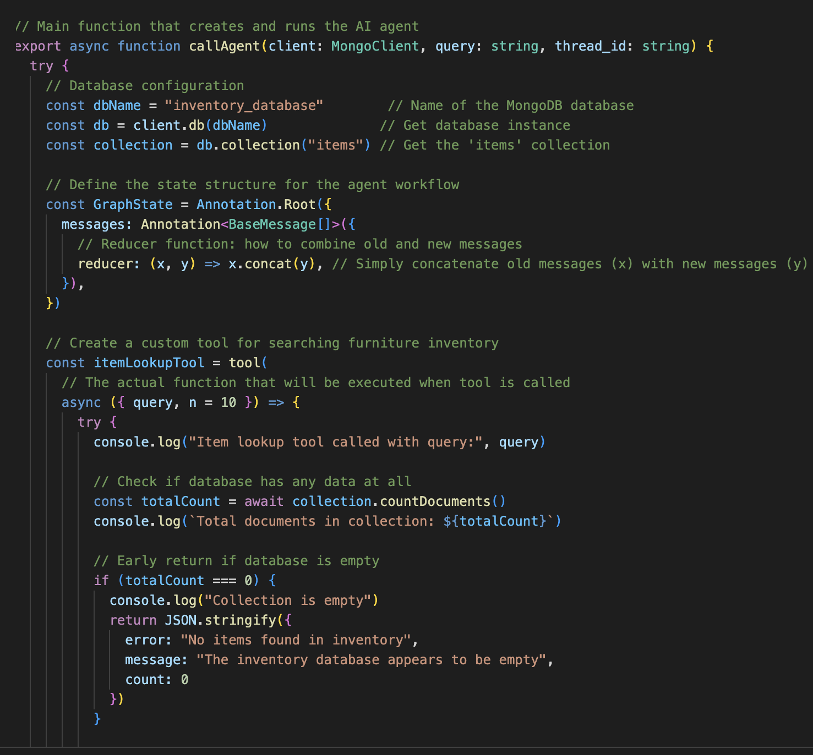
Main Function

Slide 11
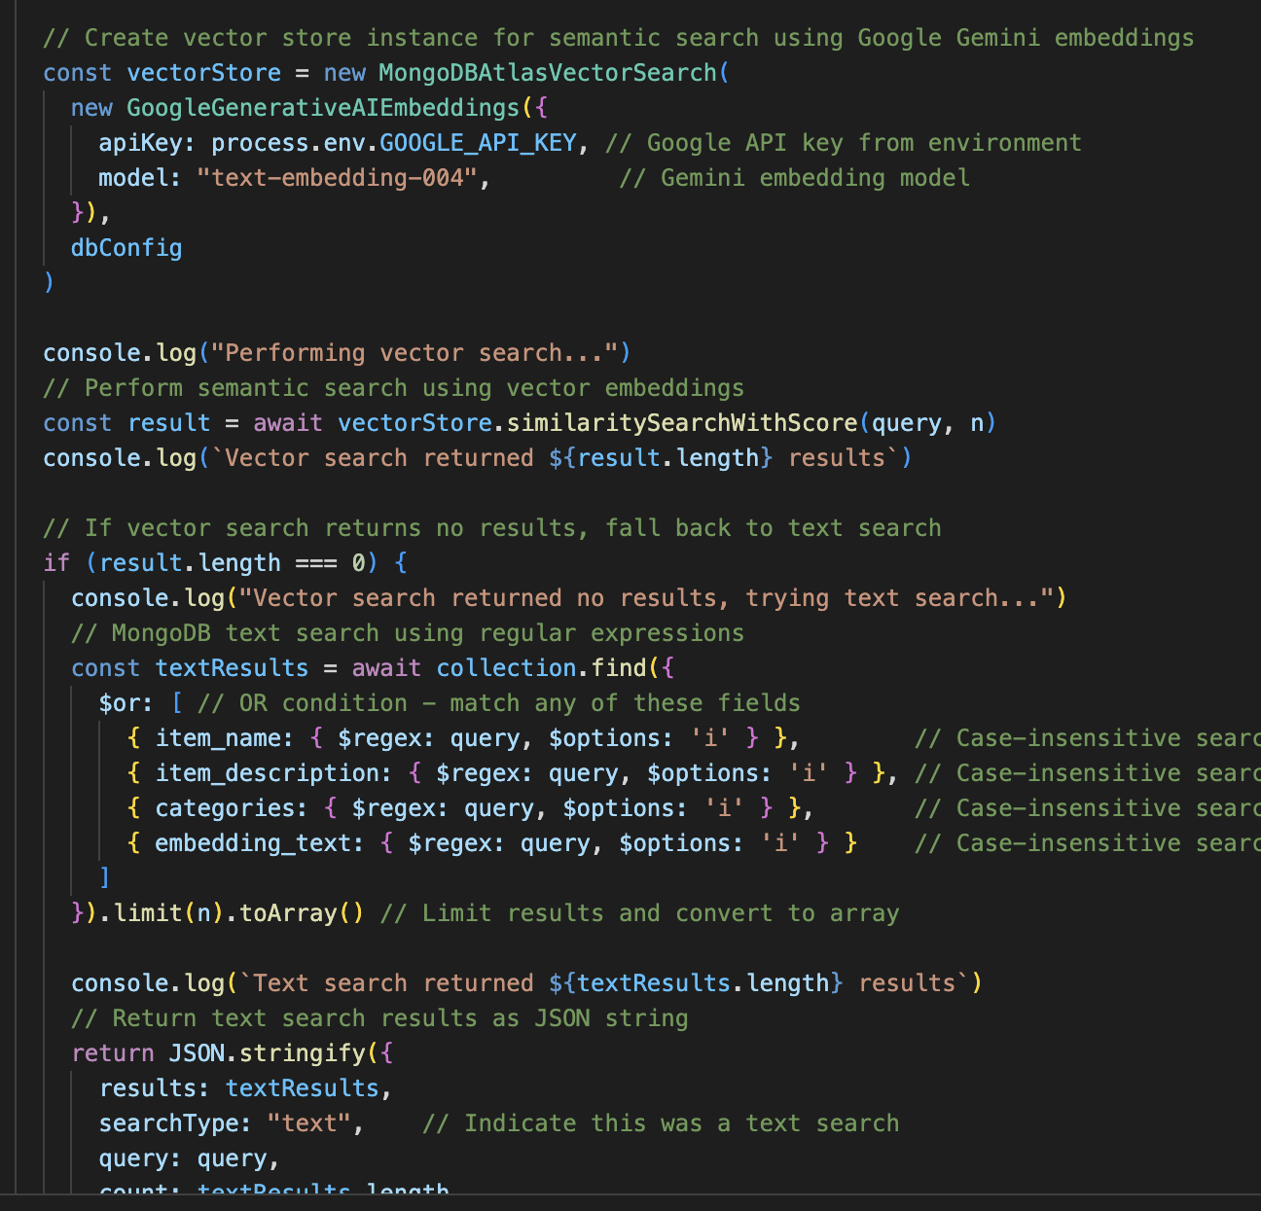
Hybrid Search

Slide 12
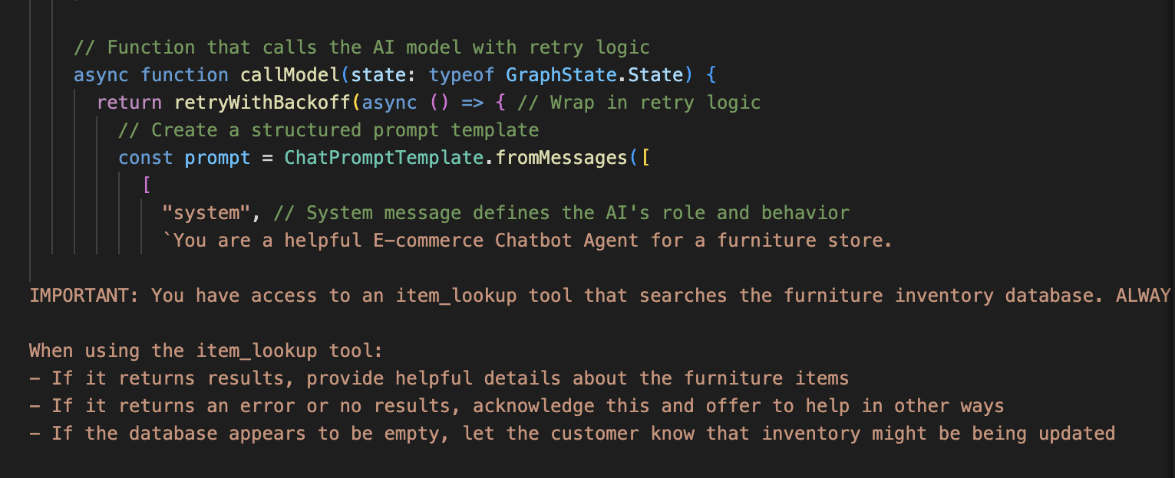
Ai Prompt

Slide 13
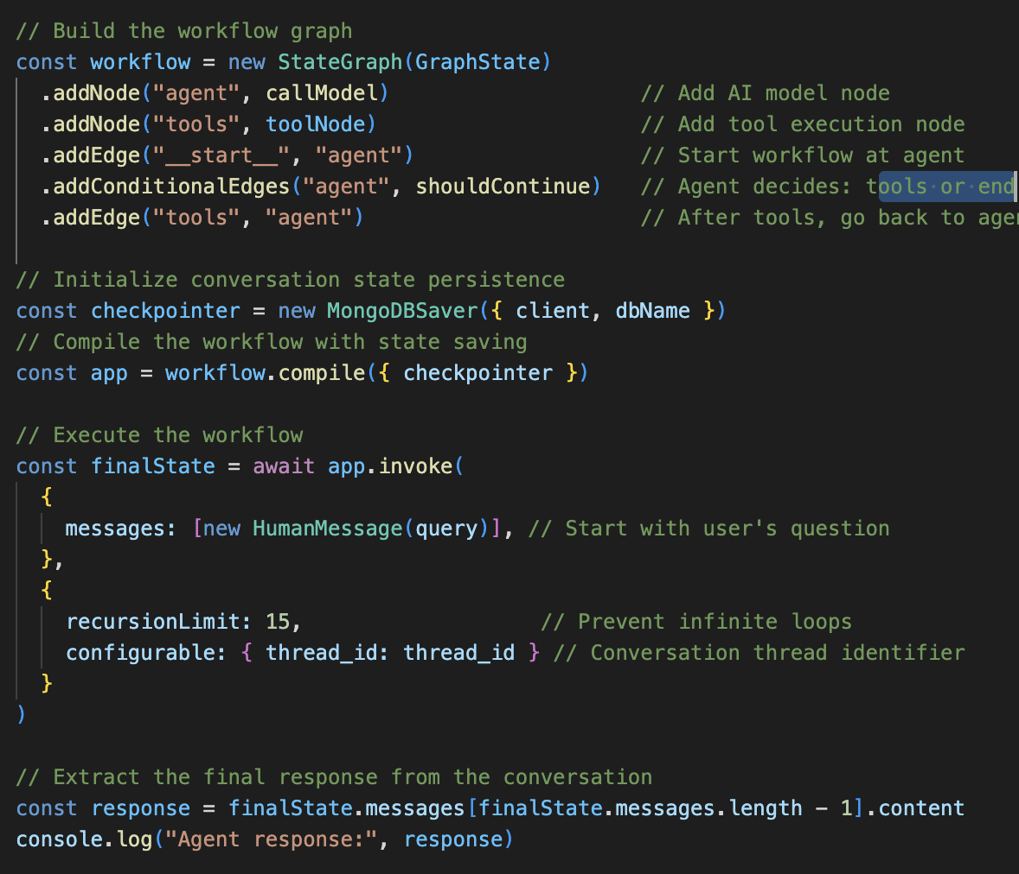
Workflow function

Slide 14
Potential Changes & Additions
Replace synthetic data with real product catalog.
Improve ranking logic between keyword and semantic results.
Expand chatbot to support recommendations & personalization, maybe assigned to each user based on user history.
Deploy on cloud platform (Eg:AWS) for scaling.

Slide 15
Questions:
Should the chatbot connect to your entire website, or only specific product/documentation sections?, conversational commerce,
Do you want it to also pull from external sources (e.g., reviews, websites, etc.)?
Do you want it to collect data too?
Will there be a set of predefined Q&A pairs / FAQs that should be included in the knowledge base along with the RAG model? Observability, hallucinations,
What data sources should form the core of the RAG pipeline?
  Private database (e.g., inventory, internal docs)
  Website content, anything
Should the chatbot be primarily customer-facing (marketing, product discovery) or internal-facing (support, inventory management)?
Since the company doesn’t have resources to train a custom LLM, should I:
  Use a pre-trained LLM API (Gemini, OpenAI, Anthropic), or
  Explore open-source LLMs that can be hosted privately?

Slide 16
Thank you!

